Slide 1
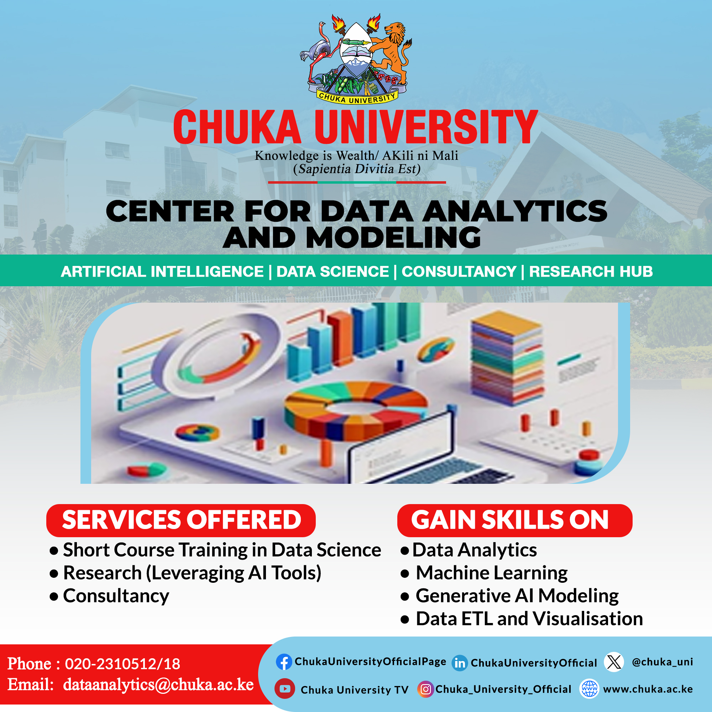

Slide 2
Introduction to Data Analytics
Professional Certificate in Data Science, Machine Learning & Artificial Intelligence
Module 1: Foundations of Data Analytics
Prepared and Delivered by:
Lumumba Wandera Victor

Slide 3
Introduction to Data Analytic
Module 1: Foundations of Data Analytics
Professional Certificate in Data Science, ML & AI
Duration: ~2-3 hours of instruction
Learning Objectives:
  Understand the strategic role of data analytics in modern organizations
  Master the data analytics lifecycle and its iterative nature
  Differentiate between descriptive, diagnostic, predictive, and prescriptive analytics
  Apply analytics thinking to real-world business problems
Visual suggestion: Modern dashboard graphic with data flow arrows

Slide 4
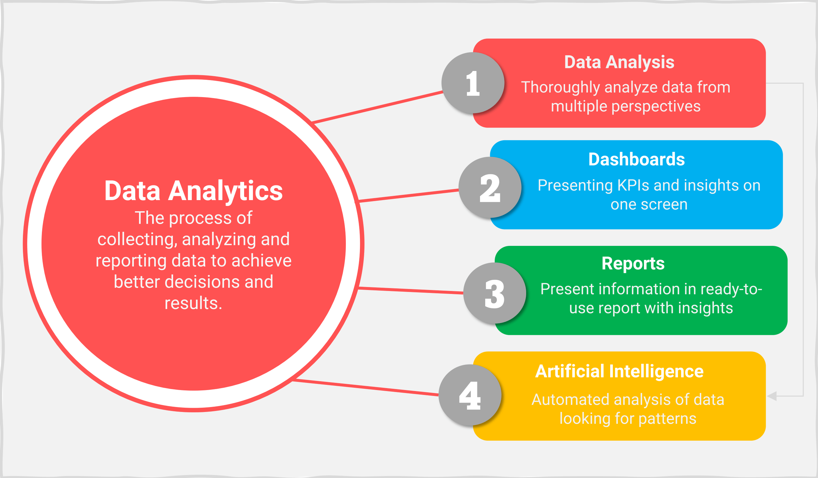
What is Data Analytics?
Definition and Core Concept
Data Analytics: The science of analyzing raw data to extract meaningful insights, identify patterns, and support decision-making
Key Components:
  Data collection and integration
  Data cleaning and transformation
  Statistical analysis and modeling
  Visualization and storytelling
  Actionable recommendation generation
Distinction from related fields:
  Data Science: Broader field including ML, AI, and advanced modeling
  Business Intelligence: Focus on reporting and historical analysis
  Data Analytics: Emphasis on insight generation and decision support
Visual suggestion: Venn diagram showing overlap between Data Analytics, Data Science, and BI

Slide 5
The Data-Driven Organization
Why Analytics Matters Today
Competitive Advantage: Organizations using data analytics are 5x more likely to make faster decisions (McKinsey, 2023)
Operational Efficiency: Analytics reduces waste, optimizes processes, and improves resource allocation
Customer Centricity: Enables personalized experiences, churn prediction, and lifetime value optimization
Risk Management: Early detection of fraud, compliance issues, and market shifts
Innovation Catalyst: Data reveals unmet needs and new market opportunities
Case Example: Netflix uses viewing analytics to guide content creation, saving $1B+ annually in production risks
Visual suggestion: Infographic showing business outcomes linked to analytics adoption

Slide 6
Benefits of a Data Driven Organizations

Slide 7
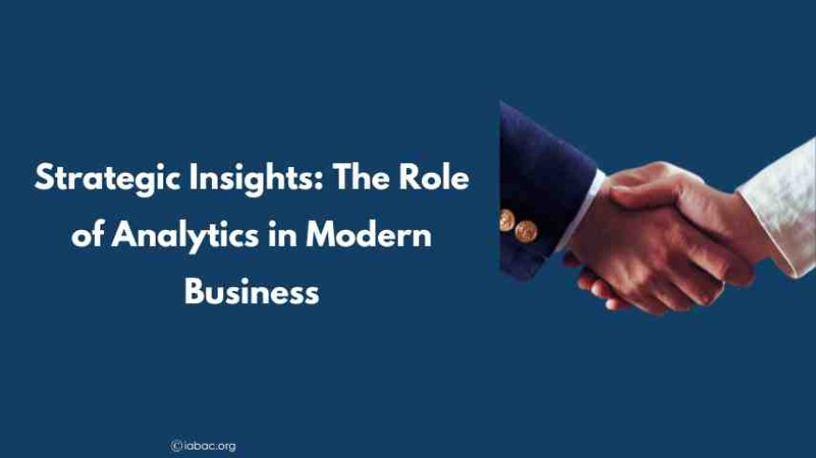
Strategic Roles of Analytics in Organizations
From Support Function to Strategic Partner
Operational Analytics: Real-time monitoring of processes (e.g., supply chain tracking, call center metrics)
Tactical Analytics: Mid-term decision support (e.g., marketing campaign optimization, inventory planning)
Strategic Analytics: Long-term planning and competitive positioning (e.g., market entry analysis, M&A evaluation)
Cultural Transformation: Fostering evidence-based decision-making across all levels
Governance & Compliance: Ensuring data quality, privacy, and regulatory adherence (GDPR, HIPAA)
Key Success Factor: Analytics must align with organizational goals and KPIs
Visual suggestion: Pyramid diagram showing operational → tactical → strategic analytics layers

Slide 8
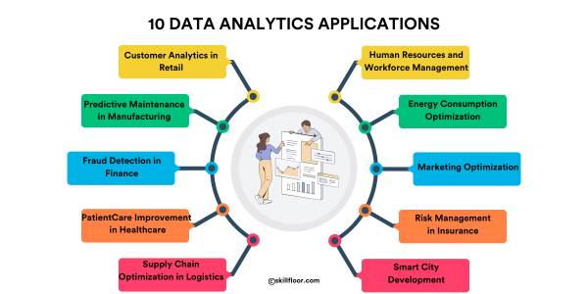
Industry Applications of Data Analytics
Sector-Specific Use Cases
Healthcare: Patient outcome prediction, resource allocation, epidemic forecasting
Finance: Credit scoring, fraud detection, algorithmic trading, risk modeling
Retail & E-commerce: Demand forecasting, recommendation engines, dynamic pricing
Agriculture: Yield prediction, precision farming, climate risk assessment
Government: Policy evaluation, public service optimization, census analysis
Education: Student performance prediction, curriculum optimization, dropout prevention
Kenya Context: Mobile money analytics (M-Pesa), agricultural extension services, public health surveillance
Visual suggestion: World map with icons representing industry applications

Slide 9
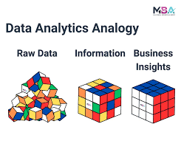
The Analytics Value Chain
From Raw Data to Business Impact
Data: Unprocessed facts and figures (transactions, sensor readings, surveys)
Information: Organized, contextualized data (reports, dashboards, summaries)
Insights: Patterns, correlations, and causal relationships discovered through analysis
Decisions: Strategic or operational choices informed by insights
Actions: Implementation of decisions (process changes, investments, interventions)
Value: Measurable business outcomes (revenue growth, cost reduction, risk mitigation)
Critical Note: Value is only realized when insights lead to executed actions
Visual suggestion: Linear flowchart with feedback loop from "Value" back to "Data"

Slide 10
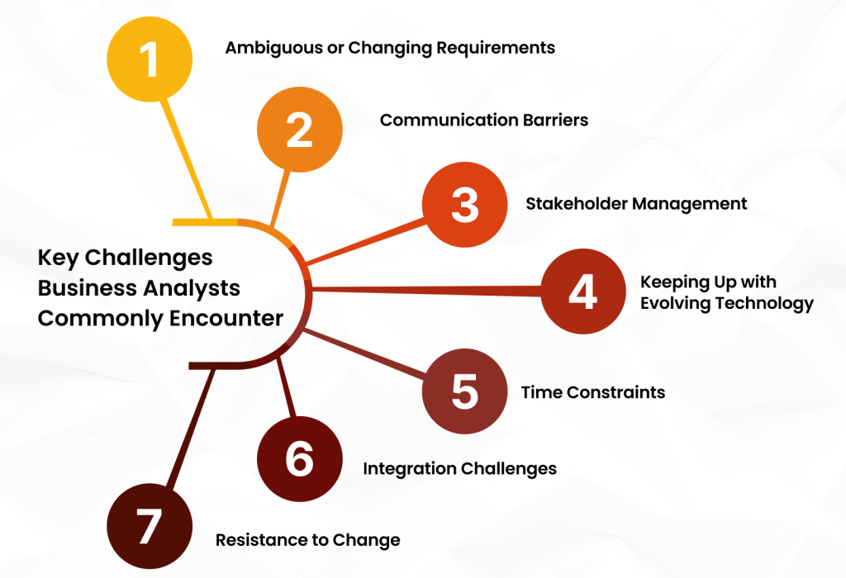
Common Analytics Challenges in Organizations
Barriers to Effective Implementation
Data Quality Issues: Incomplete, inconsistent, or outdated data ("garbage in, garbage out")
Siloed Data Systems: Fragmented data across departments hindering holistic analysis
Skills Gap: Shortage of personnel with both technical and business acumen
Cultural Resistance: Reliance on intuition over evidence; fear of transparency
Tool Proliferation: Too many platforms causing integration and training challenges
Ethical & Privacy Concerns: Balancing insight generation with data protection
Mitigation Strategy: Start with clear business questions, ensure executive sponsorship, invest in data governance
Visual suggestion: Warning icons with brief challenge descriptions

Slide 11
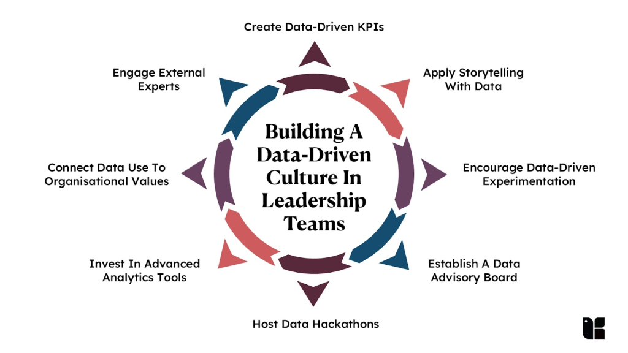
Building an Analytics-Ready Culture
Enabling Factors for Success
Leadership Commitment: Executives must champion data-driven decision-making
Cross-Functional Teams: Blend of data specialists, domain experts, and business stakeholders
Continuous Learning: Upskilling programs (like this certificate) to build internal capacity
Agile Methodology: Iterative analytics projects with rapid prototyping and feedback
Communication Frameworks: Training analysts to translate technical findings for non-technical audiences
Metrics Alignment: Ensuring analytics outputs directly tie to organizational KPIs
Kenya Application: Leverage mobile technology adoption and growing tech hubs (Nairobi, Kisumu) for analytics capacity building
Visual suggestion: Team collaboration graphic with diverse roles around a data dashboard

Slide 12
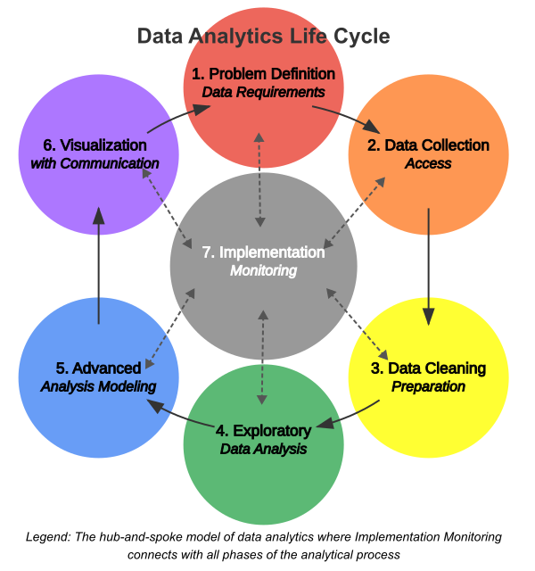
Data Analytics Lifecycle
A Structured Approach to Analytics Projects
The lifecycle provides a repeatable framework for turning business questions into actionable insights
Iterative, not linear: Learnings from later stages often refine earlier assumptions
Adaptable to project scope: Can be applied to quick exploratory analyses or multi-year initiatives
Foundation for Module 1: This lifecycle underpins all subsequent technical modules
Key Phases Overview:
  Problem Definition
  Data Collection
  Data Preparation
  Exploratory Analysis
  Modeling & Interpretation
  Communication & Deployment
  Monitoring & Iteration
Visual suggestion: Circular diagram showing 7 interconnected lifecycle phases

Slide 13
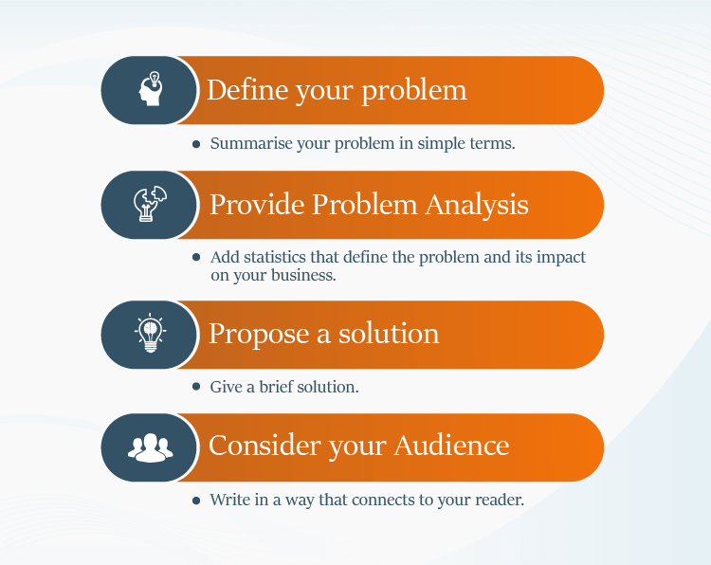
Problem Definition & Business Understanding
The Most Critical Step
Objective: Translate business needs into analytical questions
Key Activities:
  Stakeholder interviews to clarify objectives and success metrics
  Defining scope, constraints, and timelines
  Identifying required data sources and accessibility
  Establishing ethical guidelines and privacy considerations
Common Pitfalls:
  Solving the wrong problem due to misaligned expectations
  Overlooking feasibility (data availability, technical constraints)
  Vague success criteria ("improve customer satisfaction" vs. "increase NPS by 10 points")
Deliverable:
  Project charter with clear problem statement, hypotheses, and KPIs
Visual suggestion: Flowchart from "Business Question" → "Analytical Question" → "Success Metrics"

Slide 14
Data Collection & Acquisition
Gathering the Right Data
Data Sources:
  Internal: Databases, CRM, ERP, transaction logs, employee records
  External: Public datasets, APIs, social media, satellite imagery, surveys
  Structured vs. Semi-structured vs. Unstructured data
Collection Methods:
  Direct extraction (SQL queries, API calls)
  Web scraping (with ethical and legal compliance)
  Sensor/IoT data streams
  Third-party data purchases or partnerships
Quality Checks at Source:
  Assess completeness, accuracy, timeliness, and relevance
  Document data provenance and collection methodology
Kenya Context:
Leveraging open data portals (opendata.go.ke), mobile survey tools (ODK), and agricultural sensor networks
Visual suggestion: Icons representing different data sources feeding into a central repository

Slide 15
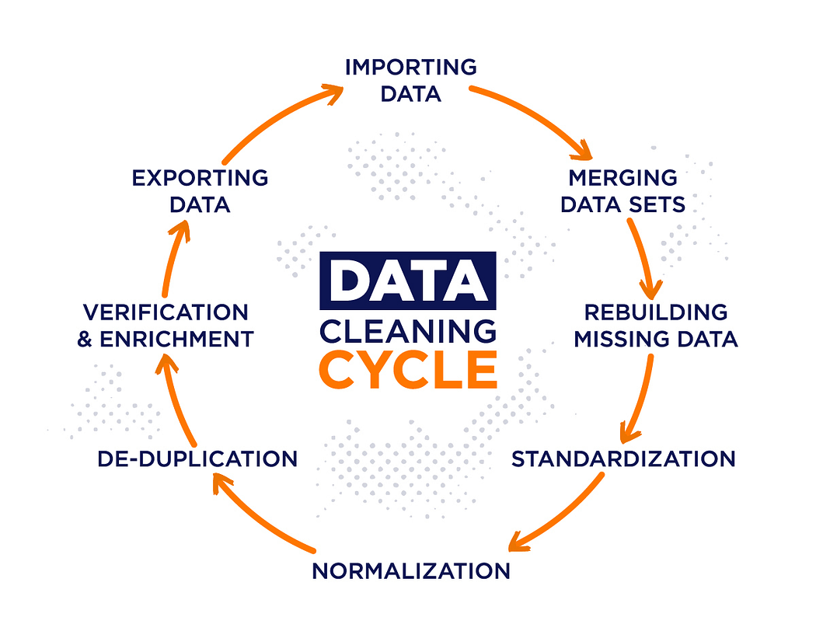
Data Preparation & Cleaning
The "80% of the Work" Phase
Why It Matters: Poor-quality data leads to misleading insights; cleaning ensures reliability
Key Tasks:
  Handling missing values: Imputation, deletion, or flagging strategies
  Outlier detection and treatment: Statistical methods (IQR, Z-score) or domain-based rules
  Standardization: Consistent formatting for dates, currencies, categories
  Deduplication: Identifying and merging duplicate records
  Feature engineering: Creating new variables from existing data (e.g., customer tenure from signup date)
Tools: Python (pandas), R (tidyverse), SQL, OpenRefine
Best Practice: Document all cleaning steps for reproducibility and auditability
Visual suggestion: Before/after data table showing messy → clean transformation

Slide 16
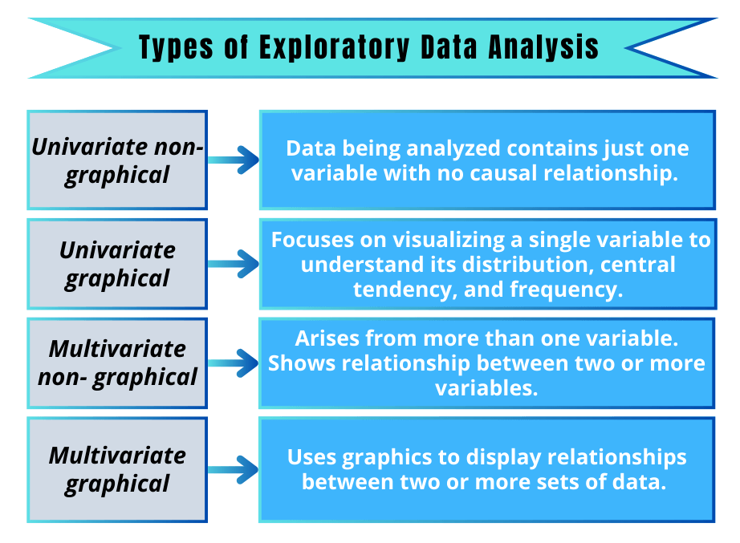
Exploratory Data Analysis (EDA)
Understanding Your Data Before Modeling
Purpose: Uncover patterns, anomalies, and relationships without preconceived hypotheses
Techniques:
  Univariate analysis: Distributions, central tendency, variability of single variables
  Bivariate analysis: Correlations, cross-tabulations, scatter plots
  Multivariate analysis: PCA, clustering, interaction effects
Visualization Tools:
  Histograms, box plots, heatmaps for distribution insights
  Scatter plots, pair plots for relationship exploration
  Time series plots for trend identification
Outcome: Refined hypotheses, identification of key predictors, data quality validation
Pro Tip: EDA often reveals the need to revisit data collection or preparation steps
Visual suggestion: Dashboard of diverse EDA visualizations (histogram, scatter, heatmap)

Slide 17
Modeling & Statistical Analysis
Turning Insights into Predictions and Explanations
Approach Selection:
  Descriptive models: Summarize historical patterns (e.g., segmentation)
  Predictive models: Forecast future outcomes (e.g., regression, classification)
  Prescriptive models: Recommend optimal actions (e.g., optimization, simulation)
Model Development Steps:
  Feature selection and engineering
  Algorithm selection based on problem type and data characteristics
  Training/testing split and cross-validation
  Performance evaluation using appropriate metrics (accuracy, RMSE, AUC-ROC)
Interpretability vs. Complexity Trade-off: Simpler models (linear regression) may be preferred for transparency over "black box" models (deep learning) in regulated contexts
Ethics Check: Assess model fairness, bias, and potential unintended consequences
Visual suggestion: Decision tree showing model selection criteria based on problem type

Slide 18
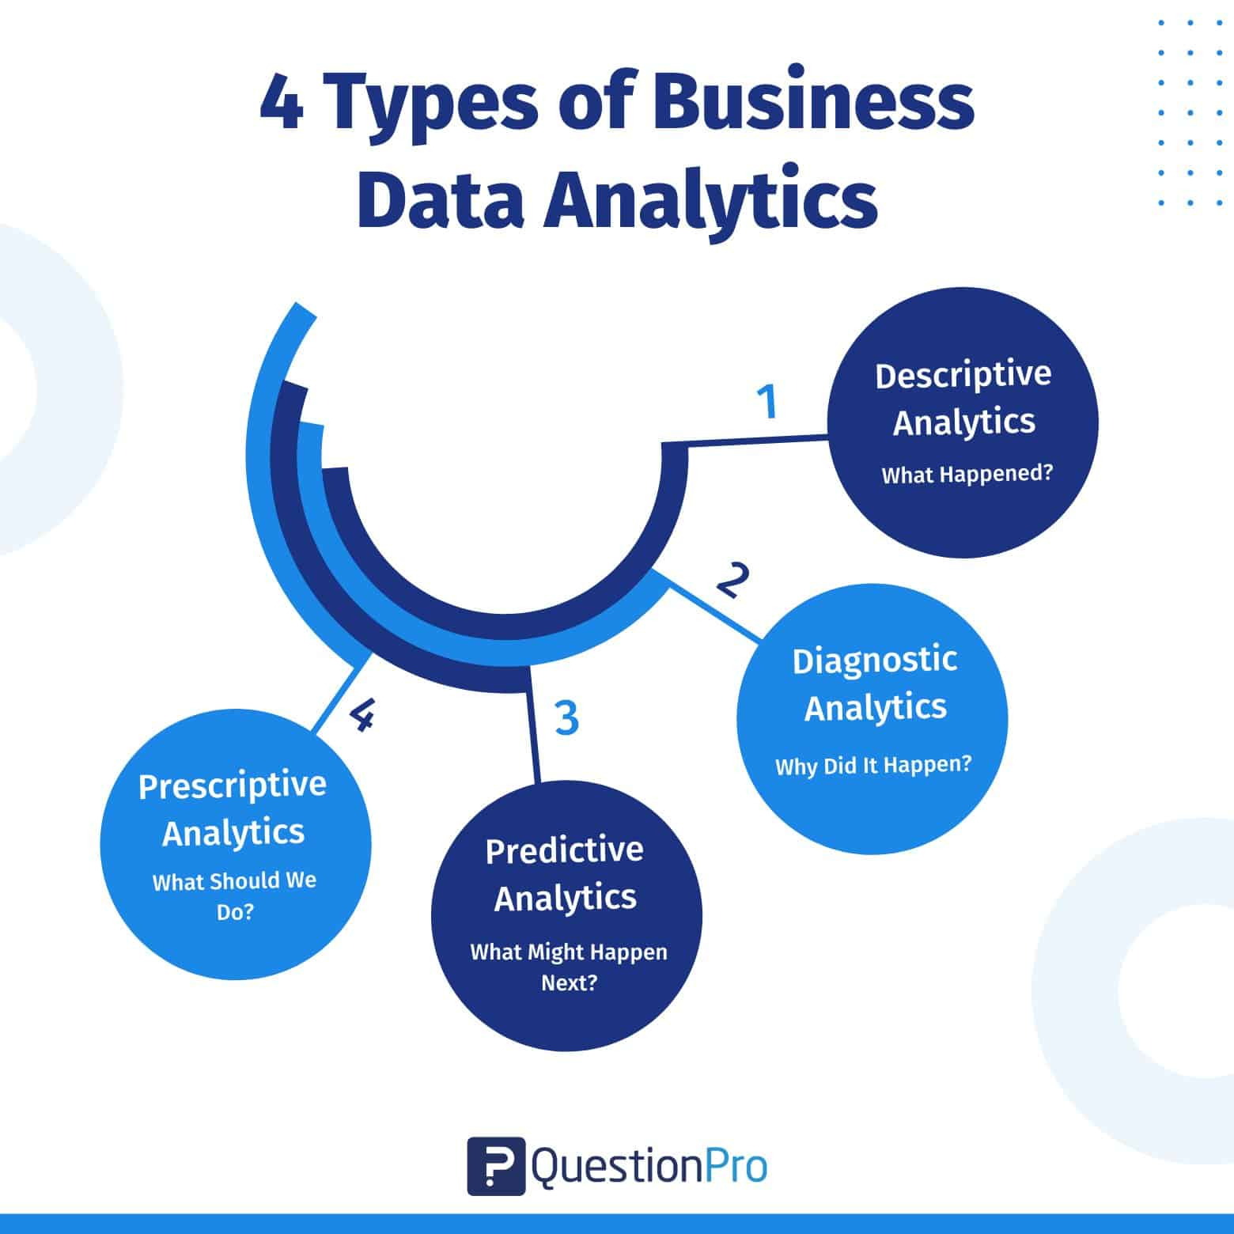
Types of Analytics
The Analytics Maturity Spectrum
Analytics capabilities evolve in sophistication and business impact:
Each type answers a different question:
  Descriptive: What happened?
  Diagnostic: Why did it happen?
  Predictive: What is likely to happen?
  Prescriptive: What should we do about it?
Organizational maturity: Most companies operate primarily at descriptive/diagnostic levels; advanced analytics requires stronger data infrastructure and skills
Strategic implication: Invest progressively; don't skip foundational steps
Visual suggestion: Maturity curve graph showing increasing complexity and value

Slide 19
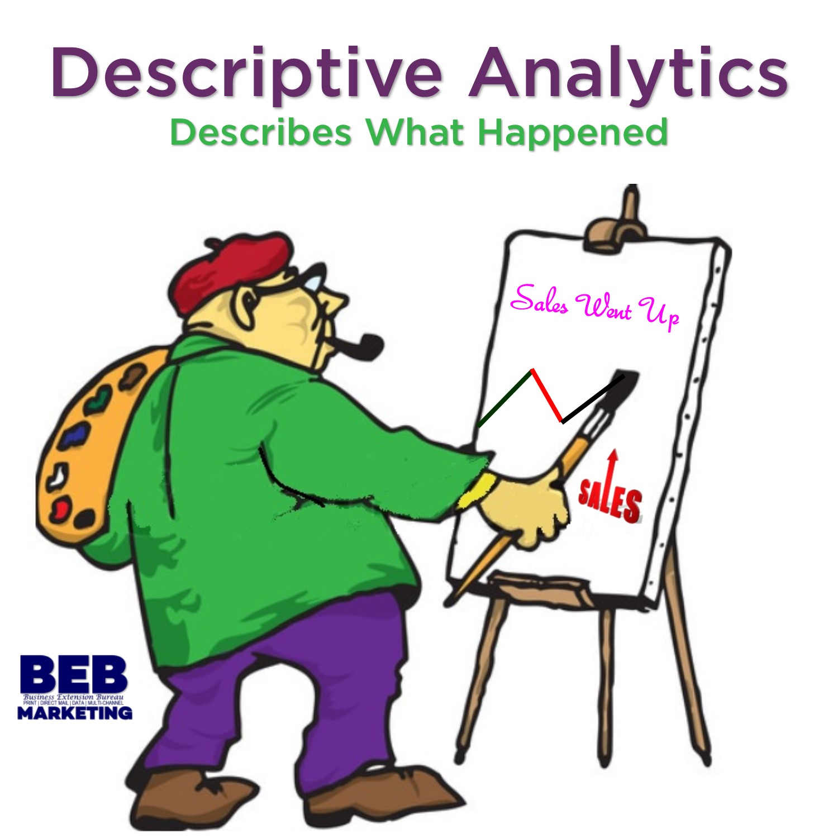
Descriptive Analytics – "What Happened?"
Foundational Insight Generation
Purpose: Summarize historical data to understand past performance
Common Techniques:
  Aggregation: Totals, averages, counts (e.g., monthly sales revenue)
  Segmentation: Grouping data by categories (e.g., customer demographics)
  Trend analysis: Time-series visualizations (e.g., website traffic over quarters)
  Benchmarking: Comparing performance against targets or peers
Tools & Outputs:
  Dashboards (Power BI, Tableau)
  Standard reports (daily, weekly, monthly)
  KPI scorecards
Limitations: Reactive; explains the past but doesn't guide future action alone
Kenya Example: Ministry of Health dashboard showing monthly malaria case counts by county
Visual suggestion: Sample dashboard with KPIs, trend lines, and bar charts

Slide 20
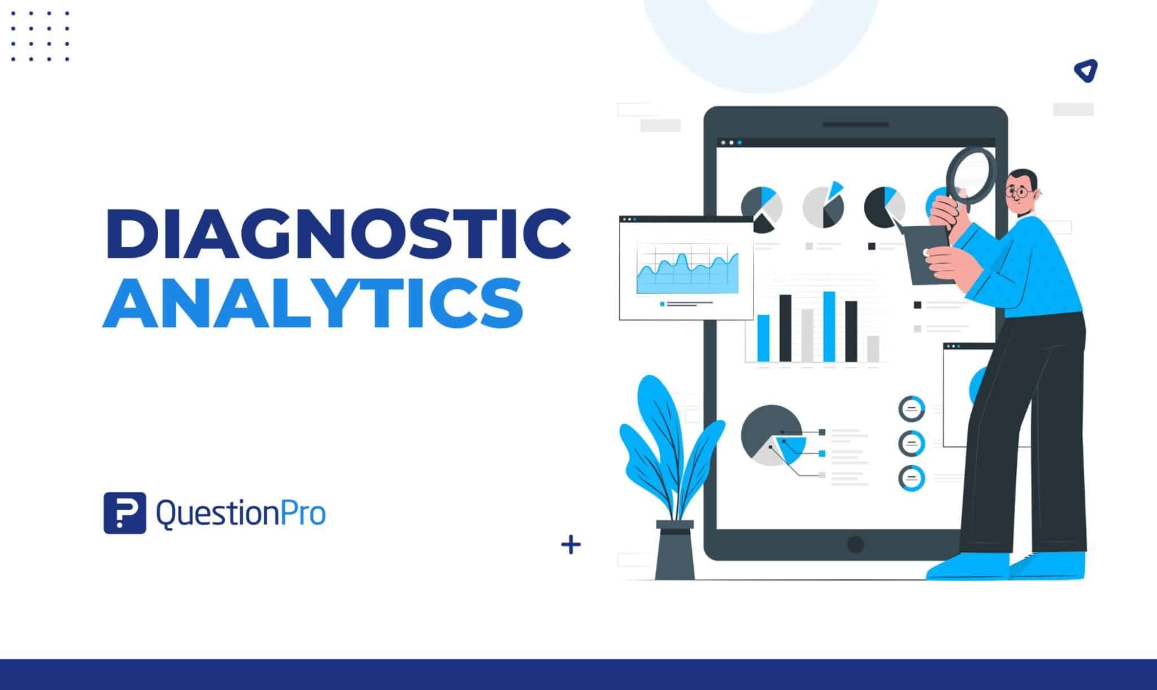
Diagnostic Analytics – "Why Did It Happen?"
Root Cause Analysis and Deeper Understanding
Purpose: Identify drivers and relationships behind observed outcomes
Common Techniques:
  Drill-down: Breaking aggregates into components (e.g., national sales → regional → store-level)
  Correlation analysis: Identifying variables that move together (e.g., ad spend vs. conversions)
  Cohort analysis: Tracking behavior of groups over time (e.g., customer retention by signup month)
  Statistical testing: Hypothesis tests to confirm if patterns are significant (t-tests, chi-square)
Key Question Framework: "What changed?" → "What factors correlate with the change?" → "Is the relationship causal or coincidental?"
Caution: Correlation ≠ Causation; diagnostic analytics suggests hypotheses but may require experimental validation
Kenya Application: Analyzing why crop yields declined in a region (weather data + soil tests + input access)
Visual suggestion: Fishbone diagram showing potential causes of a business outcome

Slide 21
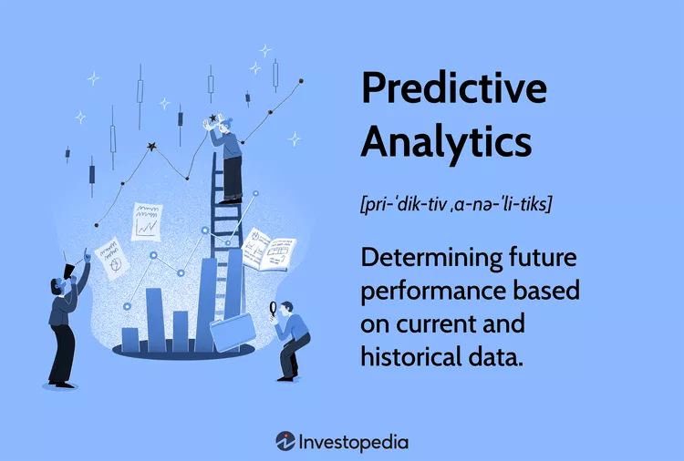
Predictive Analytics – "What Is Likely to Happen?"
Forecasting Future Outcomes
Purpose: Use historical patterns to estimate probabilities of future events
Common Techniques:
  Regression models: Predict continuous outcomes (e.g., sales volume, patient length of stay)
  Classification models: Predict categorical outcomes (e.g., churn yes/no, loan default risk)
  Time series forecasting: ARIMA, exponential smoothing for temporal data
  Machine learning: Random forests, gradient boosting for complex, non-linear patterns
Key Considerations:
  Model validation: Always test on unseen data to avoid overfitting
  Uncertainty quantification: Provide confidence intervals, not just point estimates
  Ethical implications: Predictive models can perpetuate bias if training data is flawed
Business Value: Enables proactive resource allocation, risk mitigation, and opportunity capture
Kenya Example: Predicting drought risk using climate models + satellite vegetation data to guide food security interventions
Visual suggestion: Forecast chart with actuals vs. predictions and confidence bands

Slide 22
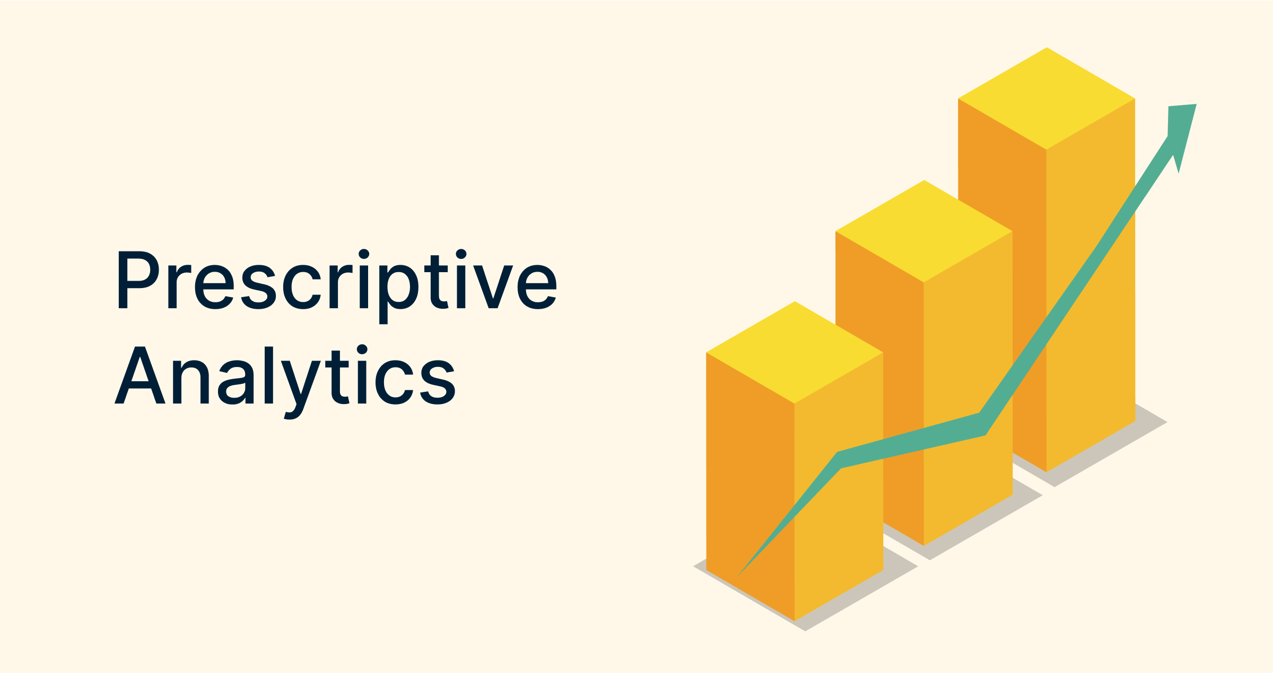
Prescriptive Analytics – "What Should We Do?
Optimizing Decisions and Actions
Purpose: Recommend specific actions to achieve desired outcomes, considering constraints
Common Techniques:
  Optimization models: Linear/integer programming for resource allocation (e.g., minimizing delivery costs)
  Simulation: Testing "what-if" scenarios (e.g., impact of price changes on demand)
  Reinforcement learning: AI systems that learn optimal policies through trial and error
  Decision trees with cost/benefit analysis: Structuring complex choices under uncertainty
Integration Requirement: Combines predictive insights with business rules, constraints, and objectives
Challenges:
  Requires high-quality data and clear objective functions
  Organizational change management to act on recommendations
  Dynamic environments may require real-time re-optimization
Kenya Application:
  Optimizing vaccine distribution routes considering cold-chain constraints, population density, and outbreak risk
Visual suggestion: Decision flowchart showing inputs → optimization engine → recommended actions

Slide 23
Comparing the Four Analytics Types
Type | Question Answered | Time Orientation | Complexity | Business Impact | Example
Descriptive | What happened? | Past | Low | Awareness | Monthly sales report
Diagnostic | Why did it happen? | Past | Medium | Understanding | Root cause of sales drop
Predictive | What will happen? | Future | High | Anticipation | Customer churn risk score
Prescriptive | What should we do? | Future | Very High | Action | Optimal marketing spend allocation

Slide 24
Sequential Building of Each Stage
Progression Insight: Each type builds on the previous; strong descriptive foundations enable reliable predictive models
Resource Implication: Complexity and data requirements increase across the spectrum
Strategic Takeaway: Organizations should assess their current maturity and invest incrementally
Visual suggestion: Comparison table with color-coded complexity gradient

Slide 25
Integrating Analytics Types in Practice
A Holistic Analytics Strategy
Real-World Workflow Example – Retail Inventory Management:
  Descriptive: Dashboard shows last month's stockouts by product category
  Diagnostic: Analysis reveals stockouts correlate with promotional periods and supplier lead times
  Predictive: Model forecasts demand spikes for upcoming holidays based on historical patterns
  Prescriptive: Optimization algorithm recommends order quantities and timing to minimize stockouts while controlling holding costs
Cross-Type Synergies:
  Diagnostic insights improve feature engineering for predictive models
  Predictive outputs feed prescriptive optimization constraints
  All types benefit from shared data infrastructure and governance
Implementation Tip: Start with descriptive/diagnostic to build trust and data quality, then layer predictive/prescriptive capabilities
Visual suggestion: Circular workflow diagram showing how the four analytics types interact in a business process

Slide 26
Key Takeaways & Next Steps
Foundations for Your Analytics Journey
Core Messages:
  Data analytics transforms raw data into strategic advantage when aligned with business goals
  The analytics lifecycle provides a repeatable, iterative framework for project success
  The four analytics types form a maturity spectrum—master foundations before advancing
  Technical skills must be paired with communication, ethics, and domain knowledge
Immediate Actions for Learners:
  Practice framing business questions as analytical problems
  Explore sample datasets using Python/R to apply EDA techniques
  Critically evaluate dashboards/reports using the descriptive/diagnostic lens
  Reflect on ethical implications of analytics in your industry context
Looking Ahead: Module 1 continues with Data Types, Cleaning, Statistics, and Visualization—building the technical toolkit to execute this lifecycle
Quote to Remember: "Without data, you're just another person with an opinion." – W. Edwards Deming
Visual suggestion: Roadmap graphic showing "Introduction" → "Technical Modules" → "Capstone Project"

